Slide 1
Voltage

Slide 2
By the end of this lesson you will be able to:
Explain what voltage is.
Describe how we measure voltage.
Explain why voltage drops occur.

Slide 3
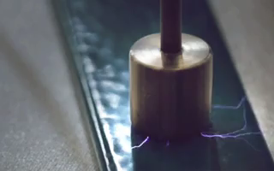
Voltage is the difference in potential energy across an energy source or circuit component.
Voltage is also called the potential difference.
The unit for voltage is the volt (V).

Slide 4
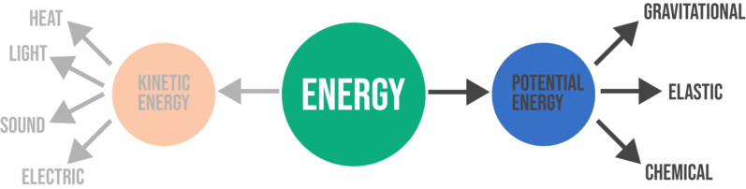
Potential energy in a circuit is a similar idea to gravitational potential energy.
If a rock is at the top of a steep hill, it will start rolling down the hill. This is because there is greater gravitational potential energy at the top of the hill than at the bottom.
Energy flows from places with high potential energy to places with low potential energy.

Slide 5
Energy is supplied by the energy source of circuit.
This energy flows around the circuit so that it can be used by the circuit components.

Slide 6
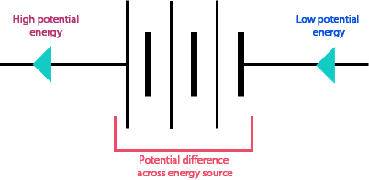
All the energy supplied by the energy source is used up by the circuit components.
This means that one side of the energy source has a high potential energy while the other side has a low potential energy.
This forms a potential difference across the energy source.
The blue arrows in the diagram below represent the direction which energy travels in (the conventional current).

Slide 7
The voltage across the energy source is the amount of energy which is supplied to the circuit.
An energy source with a high voltage supplies more energy to the circuit.
This energy is then carried around the circuit by the current. The current flows from areas of high potential to areas of low potential. Potential energy is both lost and gained as electrons flow around a circuit.

Slide 8
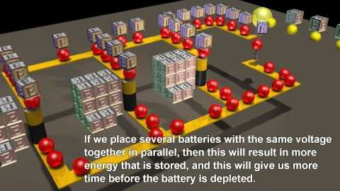
Potential energy is both lost and gained as electrons flow around a circuit.
Watch this video (2:17) for a summary of potential energy in circuits.

Slide 9
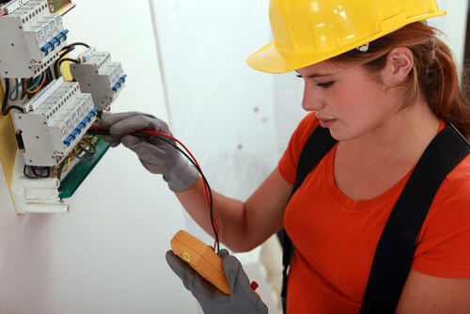
We use a voltmeter to measure the voltage between two points in the circuit.
For example, if we connect the voltmeter across the energy source, it will tell us the voltage of the energy source.

Slide 10
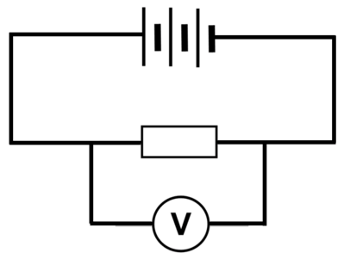
We connect voltmeters externally to the circuit component that we are measuring the voltage across.
This means that we add an extra loop onto the circuit to attach the voltmeter to instead of connecting it in line with the circuit components.

Slide 11

There is a loss of potential energy when a current flows through a circuit component.
This is because the component transforms the electric potential energy into a different form.
For example, lightbulbs transform electric potential energy into light energy.

Slide 12
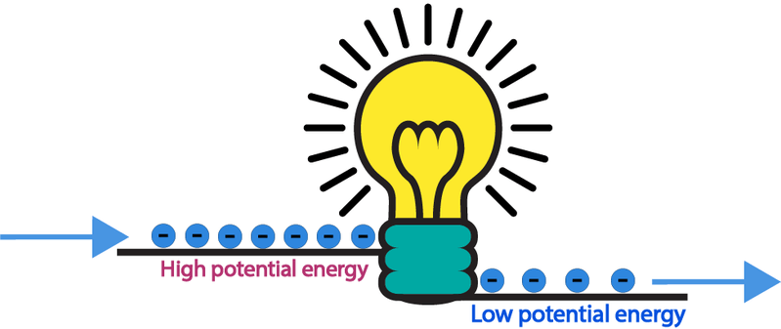
This loss of energy is called voltage drop.
There is a higher potential energy before the circuit component than after it.

Slide 13
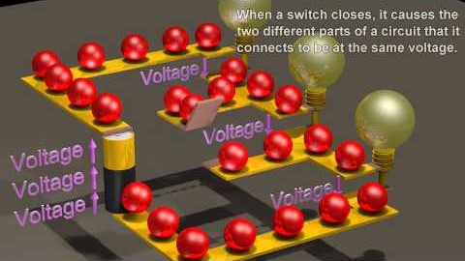
Voltage drops are essential for moving energy through a circuit component.
Watch this video (2:06) of a voltage drop across a lightbulb.

